Slide 1
Smart Solar Window with Adaptive Tracking - IntelliGlass
Idrees M. Abu Etewy July 2025

Slide 2
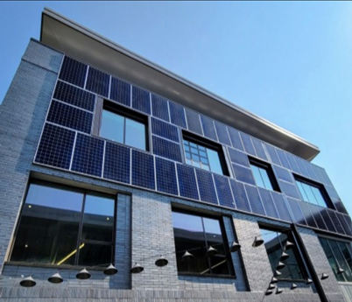
Introduction
The Smart Solar Window System combines innovative technology with sustainable practices. It integrates transparent photovoltaic materials, single-axis solar tracking, and environmental sensors to create an energy-efficient solution for modern buildings. This system adapts to environmental changes, providing ventilation while harnessing solar energy.
Paper Contents:
Introduction: Defines the problem of traditional window limitations in energy efficiency and safety. Presents the motivation behind developing a smart, responsive solar window.
Literature Review: Summarizes the evolution of solar window technology, TPV configurations, and types of tracking mechanisms.
System Overview: Provides the system block diagram and control logic process.
System Design: Details the system components, microcontroller, sensors, actuators, and PV glass.
Simulation & Results: Describes the solar tracking methodology, system simulations using Simulink, and PID controller design
Distributed System Architecture: Describe the evolution of the system to be a distributed control system.
Conclusion: Summarizes and suggests future enhancements.

Slide 3
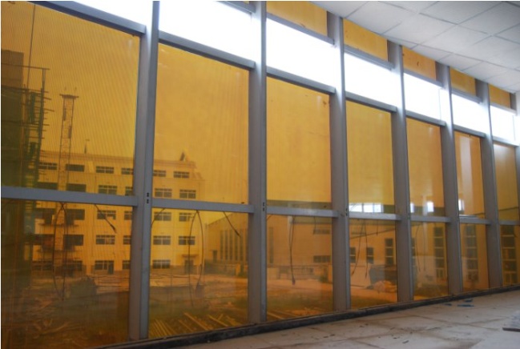
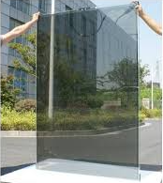
Literature Review – Transparent PV Technologies
Transparent Photovoltaic (TPV) Systems:
Spatially Segmented PV: use opaque cells in transparent surfaces, mostly for industrial applications.
Semi-Transparent Thin Film PV: are Non-wavelength Selective Thin Film Photovoltaic systems that use materials like amorphous silicon to absorb ultraviolet (UV) and infrared (IR) light while allowing partial light transmission.
Transparent Thin Film PV: are wavelength-selective photovoltaic systems designed to transmit visible light while absorbing UV and IR light. These systems use materials like polymers, nanotubes, and organic molecules to have high transparency.
Fig. Semi-transparent Thin Film PV
Fig. Transparent Thin Film PV

Slide 4
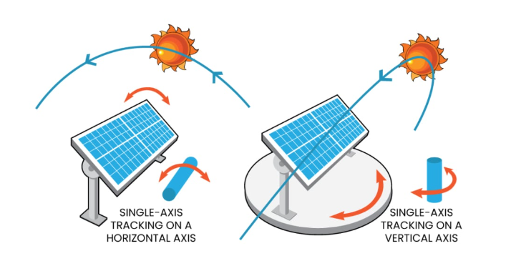
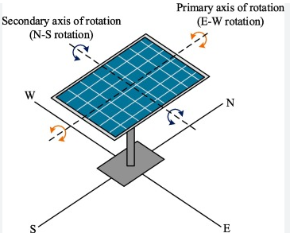
Literature Review – Solar Tracking Mechanisms
Tracking Types:
Single-Axis Tracking (currently used in the system) :
Have one degree of freedom.
Simpler and more cost-effective.
Subtypes: Horizontal (axis parallel to the ground), Vertical (axis vertical), Tilted (axis inclined), and Polar-Aligned (aligned with Earth's polar axis).
Dual-Axis Tracking:
Have two degrees of freedom.
Track in both tilt (elevation) and azimuth directions.
Types: Tip Tilt and Azimuth Altitude.
More complex and expensive, but maximizes solar energy capture
Fig. Single Axis Tracking
Fig. Dual Axis Tracking

Slide 5
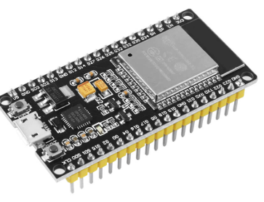
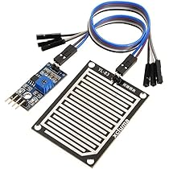
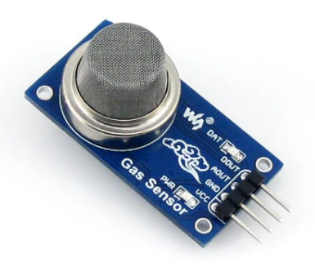
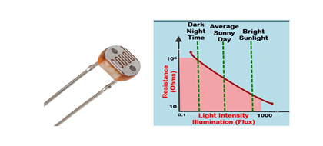
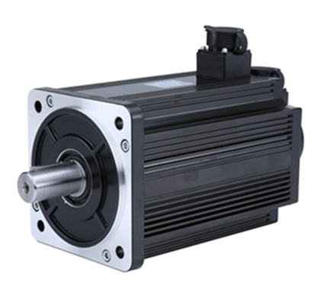
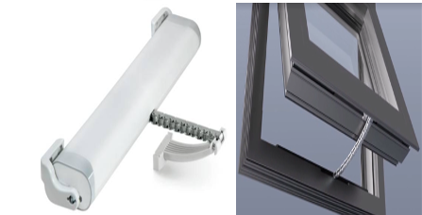
System Design – Components
Microcontroller (ESP32)
Offers Wi-Fi/Bluetooth; ideal for IoT, mobile app integration, and other features.
Sensors:
YL-83 Rain Sensor
MQ-2 Smoke Sensor
LDRs for sunlight intensity
Actuators:
Servo motor for solar tracking
Chain actuator for opening/closing window
PV Module:
Transparent or semi-transparent solar panel for electricity generation.
Fig. ESP32 Dev Module
Fig. Rain Sensor
Fig. MQ-2 Smoke Sensor
Fig. LDR and Variation of Resistance
Fig. Brushless DC (BLDC) Servo Motor
Fig. Mingardi MICRO-S Chain actuator

Slide 6
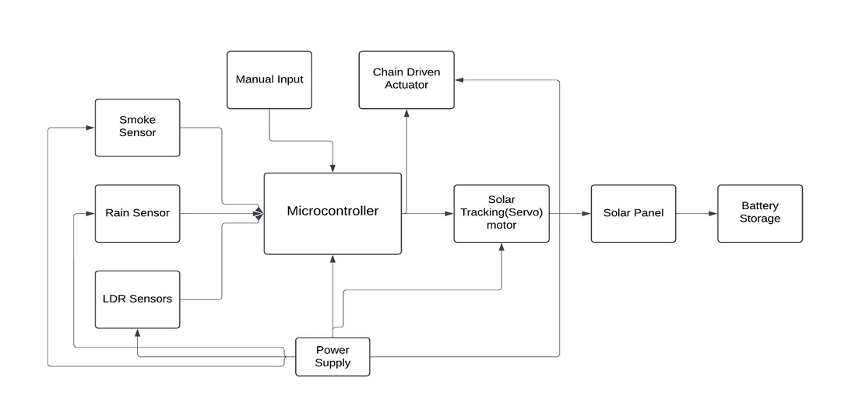
System Overview System Block Diagram:
The system integrate several critical components:
fig. System Block Diagram
LDR sensors to detect sunlight intensity.
Rain sensors (YL-83) and Smoke sensors (MQ-2) to trigger automated window control during environmental changes.
Servo motor for solar tracking, and a chain-driven actuator for opening/closing the window.
ESP32 Microcontroller to process real-time sensor data and send appropriate commands to actuators.
Transparent PV glass for daylight energy generation.
An optional energy storage system supports autonomous operation when solar input is low.
These elements interact through control logic outlined in the Figure , ensuring optimized performance and safety.

Slide 7
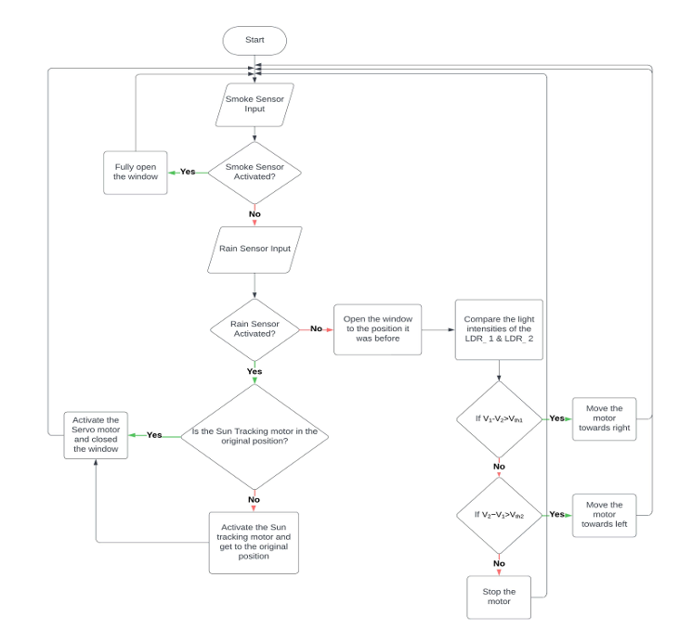
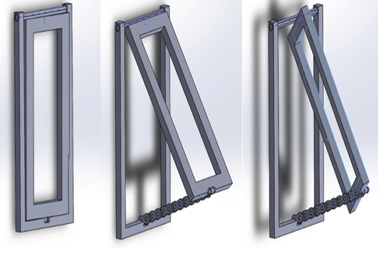
System Overview Workflow and Control Algorithm
The system reads environmental inputs and executes decision logic to actuate the window or adjust tracking.
It processes inputs from light intensity sensors to orient the panel and respond to smoke/rain conditions automatically.
Fig. Solid Works Diagrams showing Closed, Opened and Solar Tracking positions of the Window
Fig. Control Algorithm

Slide 8
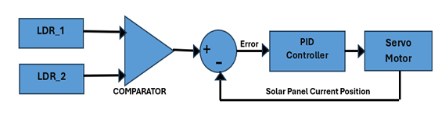
Methodology & PID Controller
The Single-Axis Solar Tracking System is implemented to maximize solar energy while maintaining adequate ventilation.
Methodology
Uses two LDR sensors to detect light difference.
Difference drives servo motor until both LDRs receive equal intensity.
PID Controller:(Proportional-Integral-Derivative controller)
P= 240 ensures quick correction.
I = 180 eliminates steady-state error.
D is omitted due to slow sun movement.
Ensures precision and simplicity.
Fig. Block Diagram of the Solar Tracking Feature.

Slide 9
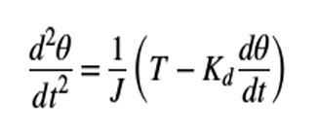
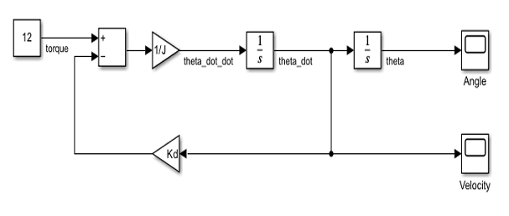
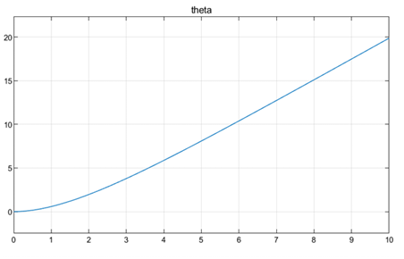
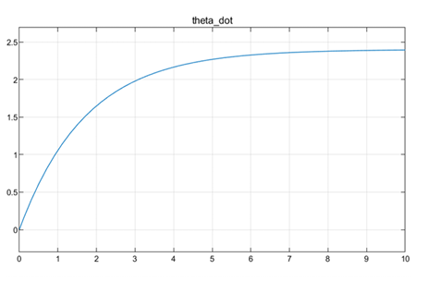
Simulating the Panel Motion
Simulates the panel’s physical motion in response to motor torque.
This simulation verifies the physical motion of the panel in response to torque applied by the motor. It uses the panel equation of motion to evaluate whether the rotation direction and behavior align with expectations.
Fig . Panel equation of motion
A constant torque causes the panel to rotate, gradually stabilizing at a constant speed.
If torque is negative, the panel rotates in the opposite direction.
This validates the system’s mechanical response under simplified conditions.
Fig . Simulink Model of the Equation
Fig . Variation of Panel Angle over time
Fig . Variation of Panel Velocity with time

Slide 10
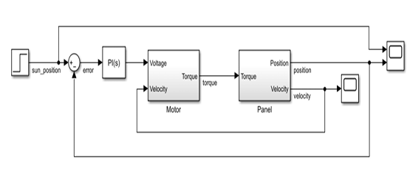
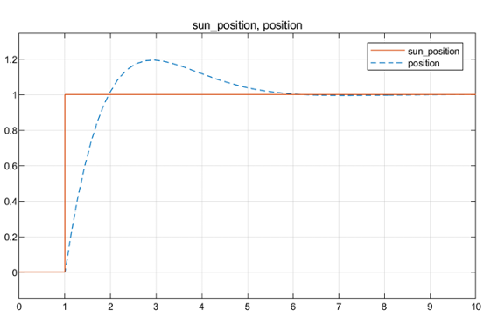
Overall Solar Tracking System Simulations
simulate the full operation of the solar tracking system under changing sunlight conditions with Simulink model
Fig . Simulink model for Single Axis Solar Tracking Simulation
Fig . Alignment of the Panel Position with the Sun’s Movement

Slide 11
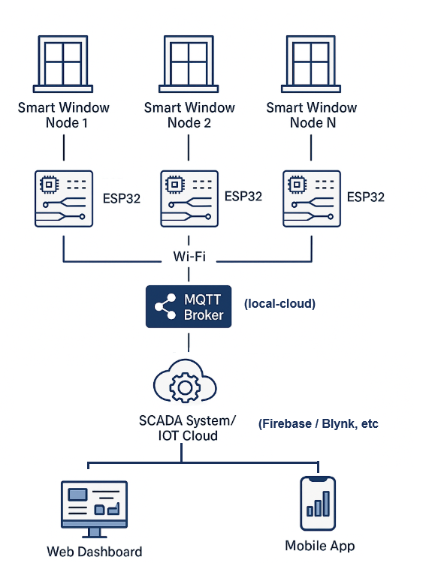
Distributed System Architecture for IntelliGlass Grid
Each smart window is a standalone unit with an ESP32 microcontroller.
The microcontroller directly manages sensors (light, smoke, rain) and actuators.
All units communicate wirelessly using the MQTT protocol.
A central MQTT broker collects data and distributes commands.
Integration with platforms like Firebase or Blynk enables cloud control, data logging, and visualization.
The system supports real-time monitoring, manual override, automated scheduling, and more features.
Fig . Alignment of the Panel Position with the Sun’s Movement

Slide 12
Conclusion & Future Enhancements
Summary
This project presents a sustainable and intelligent solar window that generates electricity while also responding to environmental conditions like rain and smoke. It integrates solar tracking, automation, and transparent photovoltaic technology to enhance energy efficiency in buildings.
Key Features
1️⃣ Transparent Photovoltaic Glass
Uses transparent thin-film PV to convert UV and IR light into electricity.
Maintains daylight visibility while generating solar energy.
2️⃣ Single-Axis Solar Tracking
Dynamically adjusts the window angle using LDR sensors to follow the sun’s path.
Increases energy generation throughout the day.
3️⃣ Automation & Safety
Rain Sensor triggers auto-closing of the window..
Smoke Sensor triggers full opening for ventilation in emergencies.
Built-in PID control for accurate panel positioning.
4️⃣ Manual & Scheduled Operation
User-defined open/close positions.
Option to run on a pre-set schedule for daily ventilation.
5️⃣ Precision with Chain Actuation
Smooth and reliable chain-driven actuator for window movement.
Integrates a rotary motor for solar alignment with minimal mechanical error.
.
Future Enhancements
Implement a dual-axis tracking system for finer solar alignment.
Integrate machine learning for predictive scheduling based on environmental data.
Develop a mobile/web app interface for remote monitoring.

Slide 13
Thank you! Any questions?

